Slide 1
Predicting the NFL Game Winner
Group 1
Samuel aboma
Samuel Kuczynski
Felipe Serrano
vYtas stuopis

Slide 2
Agenda
Topic Discussion
Technologies Used
Questions we will be answering
Data Discussion
Model Discussion
Data Visualizations
Questions

Slide 3
Topic Discussion - Popularity
Interest in on of the most popular American sports where billions of dollar are spent. You can see the popularity of the NFL from a young age as kids grow up playing the sport and wanting to be like their favorite athlete. The appeal of the sport doesn’t stop once adult hood is reached as Sundays turn into traditions with friends and family.
As the NFL continues to expand it’s global market and reach with multiple international games during the year and NFL Player Pathway Program for international players.
From friendly wagers on rivalry games with a family member to the million/billion dollar industry of sports better and the more recent introduction of daily fantasy sports.
Are you one who studies the numbers and comes with a notepad of ranked players or do you just fly by the seat of your pants and pick the name that sticks out to you most when drafting your yearly season long fantasy team. There may be a madness to your method or you just find players you know and like to draft to your team, either way it’s a fun way to stay in touch with friends from afar.

Slide 4
Topic Discussion – Keys to the game
The second element of the sport is the strategy behind every move. With data analytics becoming increasingly used, sometimes it’s hard to figure out if certain play designs are called due to the audible by the quarterback or if the analytics tell the coordinators that the best chance for success lies with a halfback rush up the A gap on third and short. As technology and additional data points become available to teams and players, the more teams clamor for any additional competitive advantage.
Does coaching impact the game, for many the answer is yes. It’s the preparation of the coaches in the film room not only during game week but during the off-season when there are no games. Finding what could have been done differently, mistakes to improve on the following year, with common opponents it’s all about finding their one weakness. Also, with free agency and trades, coaches and scouts need to be well versed on how certain players can fit their schemes.
Team strengths is taking advantage of what your team does well. Does your offensive line run block well, get a good running back and see your ground game take off! Does your team rush the quarterback well, find ways to take advantage of weaknesses in the opposing offensive line.

Slide 5
Technologies Used
Open ML: Data
Quick DBD: ERD Diagram Creation
Python: Cleaning Data
AWS: Server
PGAdmin: SQL

Slide 6
Questions we will be answering
With this data we are looking to create a machine learning model to analyze the impact key metrics have on the likelihood of winning football games in the NFL.
We will train this model using specific statistics from every game including playoffs since 2010. This data includes many different statistics listed below but we are going to focus on three specifically:
Points Scored
Turnovers
Time of Possession
We believe that these statistics play a major part in winning football games and will provide us the best model. Teams who rank high in these statistics should be winning more playoff games and also competing for or winning SuperBowls more often. This model should provide us with ideal targets for these statistics that would give clear indicators on what a team should target to win the game on any given Sunday.

Slide 7
Data Discussion
The data set we chose is NFL game statistics from the 2002 to 2022 years scraped from ESPN Team States page for each game. The games for each year include 256 games from the regular season and 11 playoff games. In the data set from the games in the NFL season, there are 3 from all the seasons that were missing and not included.
Variety of statistics for each game
General statistics
Date of the game, Home Team, Away Team, Date of the game, Score
Offensive statistics
Efficiency on first, third and fourth downs, Passing yards, Completion attempts, Rushing yards & attempts, Redzone statistics, Time of possession
Defensive statistics
Sacks, Turnovers, Defensive Touchdowns

Slide 8
Data Exploration
In this project, we aim to predict the winner of NFL games based on certain features such as turnovers, score, possession, and home advantage. The dataset used in this project is contained in the 'final_nfl_data.csv' file. We started by importing the necessary libraries such as NumPy, Pandas, Pathlib, and collections. We also imported the required methods from Scikit-learn and imblearn libraries such as balanced_accuracy_score, confusion_matrix, and classification_report_imbalanced.
After importing the necessary libraries and methods, we loaded the dataset into a Pandas dataframe using the read_csv method. We then checked the dataset for any null values, and dropped the null columns and rows using the dropna method. We also reset the index of the dataframe using the reset_index method. Since we would not be using the 'date', 'team_id', and 'name' columns in the prediction, we dropped them using the drop method.
To gain insights into the data, we printed the description of the features using the describe method to get a statistical summary of the data. Overall, the data exploration phase of this project involved loading the dataset into a Pandas dataframe, checking for null values, dropping irrelevant columns, and creating the features and target variables for the model.

Slide 9
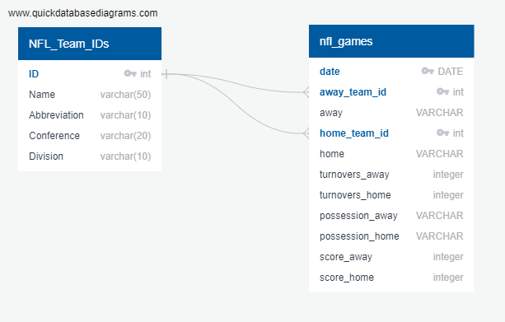
ERD DIAGRAM

Slide 10
Project Analysis Phase
In this phase, we aim to predict the winner of NFL games using available data. The analysis begins with importing the necessary packages and loading the data from the 'final_nfl_data.csv' file. The dataset contains various features such as home advantage, turnovers, score, and possession, and the winner column is the target variable.
We start by cleaning the data by dropping any null columns and rows using the dropna method, and removing any irrelevant columns such as 'date', 'team_id', and 'name'. The possession column is also converted into seconds using the timefinder function. We then calculate descriptive statistics for the features using the describe method, and note that the target variable has a balanced number of values. The data is then split into training and testing datasets using the train_test_split method, with 80% of the data being used for training. Next, we scale the data using the StandardScaler function to normalize the features.
We then fit a decision tree classifier model using the training data, and make predictions on the testing dataset. We evaluate the model's performance using the confusion matrix, accuracy score, and classification report. The model's accuracy score is 72.98%, indicating that there is still room for improvement.
Therefore, we implement a regression model that enhances the accuracy up to roughly 81.37%, which is relatively high and suggests the model's ability to correctly predict the winner.
Overall, the model has shown promising results in predicting the winner of NFL games. By cleaning and preprocessing the data, and training a decision tree classifier model, we were able to accurately predict the winner of NFL games using a set of features

Slide 11
Model Discussion
Decision Tree Classifier
Supervised learning
Classification and regression tasks
Nodes and branches
Logistical Regression
Statistical model
Classification
Predictive analytics

Slide 12
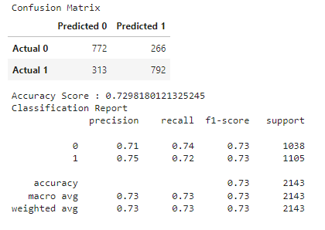
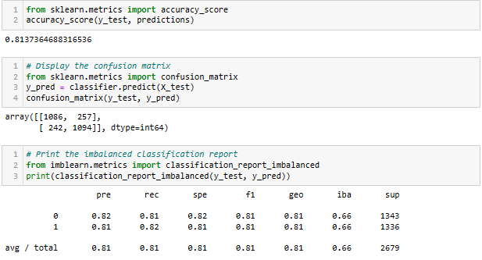
Was the model successful?
Decision Tree
Logistical Regression

Slide 13
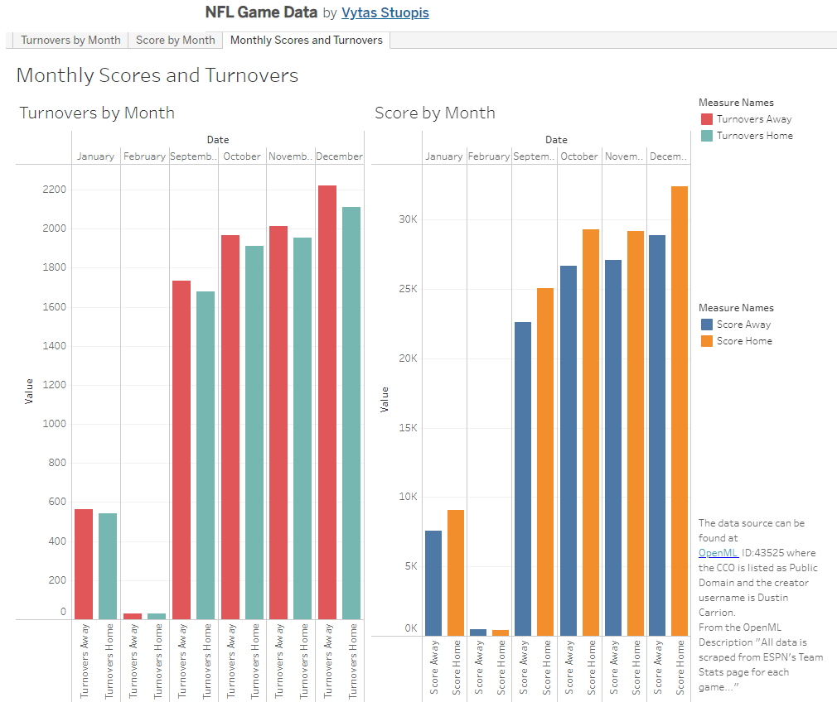
Data Visualizations Used
https://public.tableau.com/app/profile/vytas.stuopis/viz/NFLGameData_16803752169090/Dashboard1

Slide 14
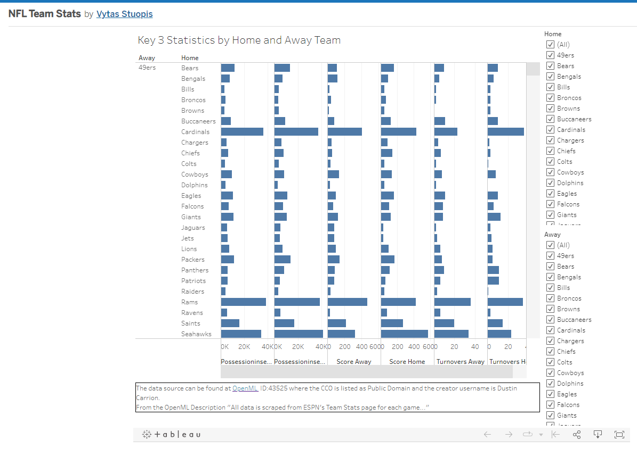
Data Visualizations Used
https://public.tableau.com/app/profile/vytas.stuopis/viz/NFLTeamStats_16806554198700/AllStatsbyHomeandAwayTeam

Slide 15
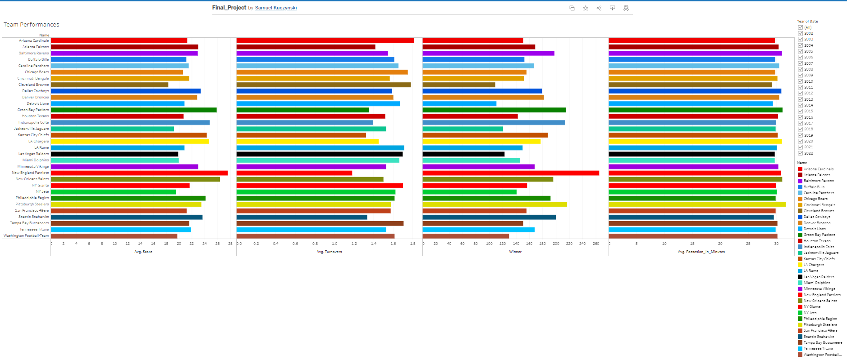
Data Visualizations Used
https://public.tableau.com/app/profile/samuel.kuczynski/viz/Final_Project_16807594084690/Dashboard1

Slide 16
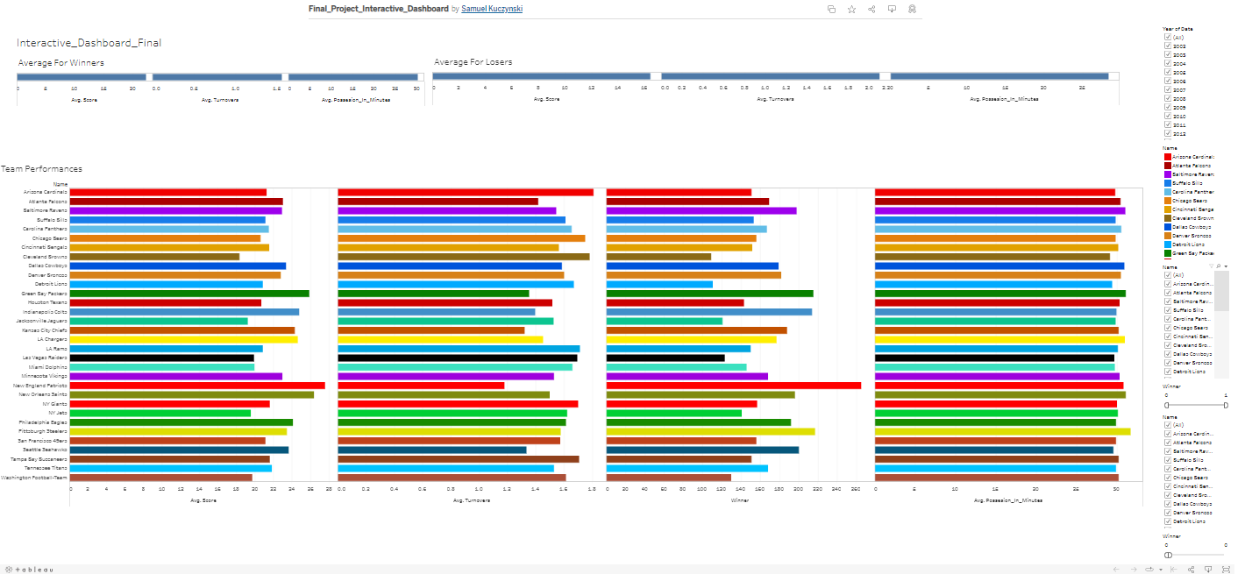
Interactive Dashboard
https://public.tableau.com/app/profile/samuel.kuczynski/viz/Final_Project_Interactive_Dashboard/Interactive_Dashboard_Final

Slide 17
Questions
?

